Slide 1
THE TASS COMMUNITY:
GROWING AND LEARNING TOGETHER
Every day excellence for EVERY child
Parent Workshop
Using Concrete Resources
“I have come that they may have life, and have it to the full.”
John 10:10

Slide 2
Using Concrete Materials
Concrete materials, or maths manipulatives, are the hands-on resources used in classrooms to develop children’s understanding of mathematical concepts. It was not long ago that these concrete resources were relegated to KS1 classrooms only. With increasing numbers of schools adopting a mastery approach to teaching maths, manipulatives are now a common feature of maths lessons across all classes at primary school - and even secondary school.

Slide 3
Using Concrete Materials
Children are given guidance on which manipulatives to select and how to use them. Over time, children are guided towards making their own choice of manipulatives - this allows them to take ownership of their own learning and development.
Concrete materials, or manipulatives, should play a central role in maths teaching. They are not just for young pupils, and also not just for those who can’t understand something. They can always be of help to build or deepen understanding of a mathematical concept.

Slide 4
Using Concrete Materials
At Totley All Saints, we follow a mastery approach to maths. Mastery is when a mathematical concept or skill has been mastered.
This means that a child can:
show it in multiple ways
use mathematical language to explain their ideas
independently apply the concept to new problems in unfamiliar situations

Slide 5
The Five Big Ideas of Maths Mastery
Coherence - Lessons are broken down into small connected steps that gradually build up from what a child already knows to the introduction of new concepts.
Representation and Structure - Representations are used in lessons to show children a visual representation of the maths they are doing.
Mathematical Thinking - Children work on ideas by discussing with others and explaining their reasoning, rather than being told how to think.
Fluency - Quick and efficient recall of facts and procedures is vital, so that it can be applied in different contexts.
Variation - The teacher often represents the concept being taught in more than one way, to develop a deeper understanding. Children are also given the opportunity to practise their skills in varied ways, by making connections.

Slide 6
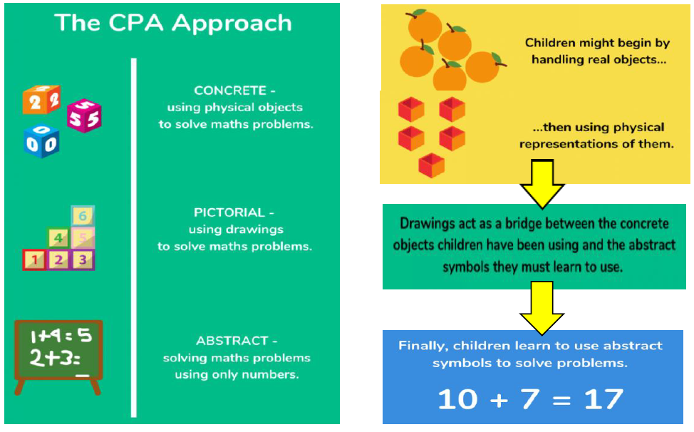
Concrete – Pictorial - Abstract

Slide 7
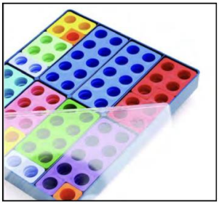
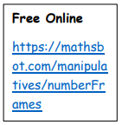
Numicon
Each Numicon shape contains holes, representing numbers from 1 to 10.
It is an excellent, multi-sensory way for children to develop a sense of number.
Patterns are structured so that number relationships can be seen and experienced.
Numbers can be compared easily.
Pieces are weighted according to size.
They can be used from FS2 to Year 6.

Slide 8
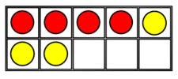
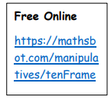
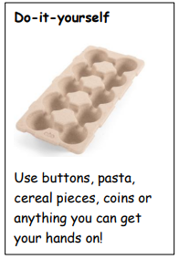
Tens Frames
These are rectangular frames split into ten sections.
They help children to learn basic number facts.
They help children to visualise numbers within ten and beyond.
They are an excellent representation when bridging ten e.g. 8 + 7
They can be used to add and subtract decimals in upper KS2.

Slide 9
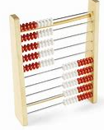
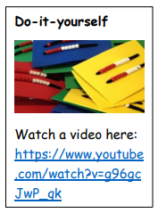
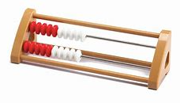
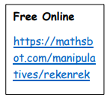
Rekenreks
These come as a bead string of 20 beads in two rows of ten or 100 beads in ten rows of ten, with five red and five white beads on each rod.
They give a visual model encouraging children to build numbers in groups of five and ten and to use doubling and halving strategies and to solve addition and subtraction problems.
They help give a mental image, which helps to build automaticity of number facts.
They support children to subitise numbers.

Slide 10
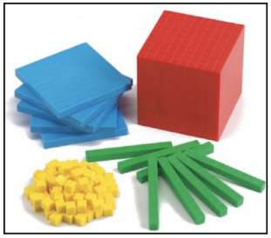
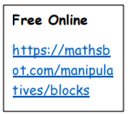
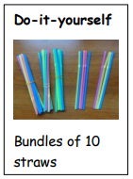
Base Ten
They consist of ones cubes, tens rods, flat hundred squares and thousand blocks, which children can use to build and represent numbers.
They are a fantastic visual way for children to understand the relationship between ones, tens, hundreds and thousands.
They help children to see when they need to exchange, e.g. 10 ones for a ten
They can also be used to represent decimals and percentages.

Slide 11
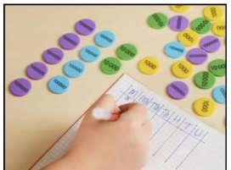
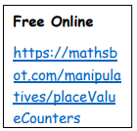
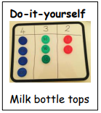
Place Value Counters
They are similar to Base 10, but are all the same size.
They are used mainly in Year 3 onwards.
They enable pupils to work with much larger numbers more easily.
They can be used to represent decimal numbers.
They prevent children from becoming over-reliant on being able to see the difference in size of numbers represented by Base 10.

Slide 12
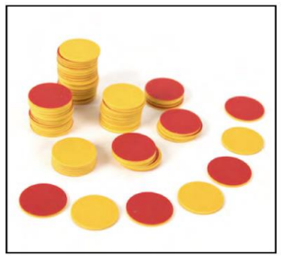
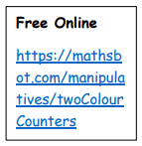
Double Sided Counters
2-sided counters are a simple but very effective resource.
They have a diverse range of uses and can be used to support a wide range of maths concepts across all year groups, e.g. arrays of multiplication facts in Year 3, algebra in Year 6.
They can be a great way to help children solve problems.

Slide 13
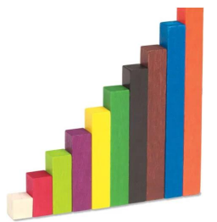
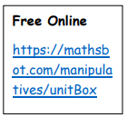
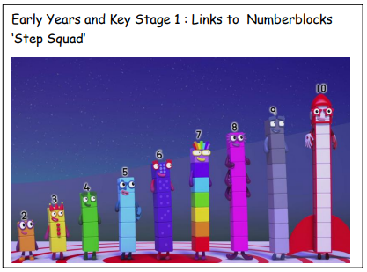
Cuisenaire Rods
Cuisenaire rods are colour coded depending on their size (from 1cm to 10cm).
They provide an interactive, hands on way to explore maths concepts, such as number bonds, fractions, decimals and ratio.
They can also be used to represent bar models to help with problem solving.

Slide 14
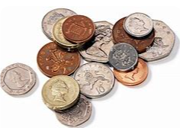
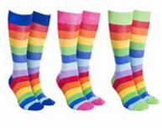
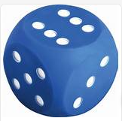
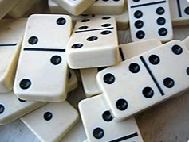
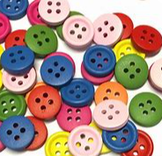
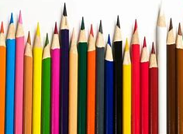
Other Resources

Slide 15
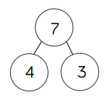
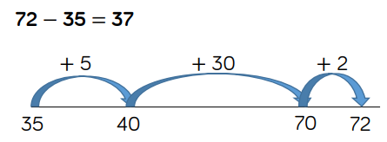
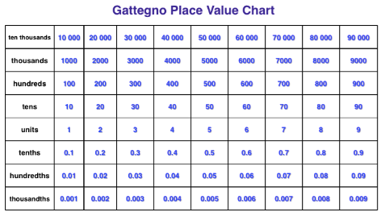
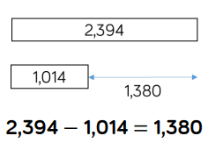
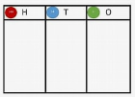
Representations
number lines and racks
part whole models
place value charts

Slide 16
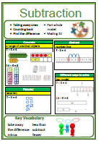
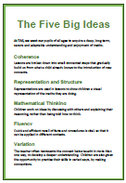
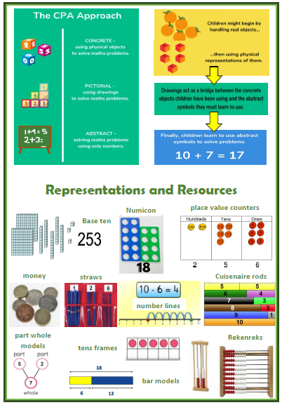
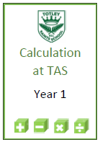
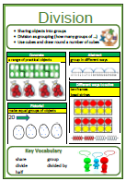
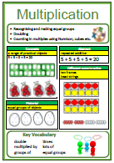
Calculation Booklets

