Slide 1
THE TASS COMMUNITY:
GROWING AND LEARNING TOGETHER
Every day excellence for EVERY child
Parent Workshop
Mastering Number
“I have come that they may have life, and have it to the full.”
John 10:10

Slide 2
Why is Maths so important?
It’s good for your brain.
It helps you tell the time.
It enables you to look after your finances effectively.
It helps you to cook for yourself.
It develops your problem solving skills.
A minimum basic level of maths is needed for the majority of jobs, from operating a till to measuring fabrics to designing buildings.
It’s all around us, and helps us to understand the world better.
It’s fun!

Slide 3
Mastering Number at Key Stage 1
Maths starts with number, so at TAS, we want all children to:
develop enjoyment and resilience
see themselves as mathematicians
talk about their learning in maths
explain their reasoning
develop a positive attitude to maths
be confident
not be afraid to make a mistake

Slide 4
Mastering Number at Key Stage 1
At TAS, we have chosen to follow the ‘Number Sense’ scheme to give children an excellent foundation in number.
The scheme starts with a daily session in Reception class, Year 1 and Year 2.
Sessions last for around 15 minutes.
It continues until the end of the Autumn term in Year 3, to bridge the gap between KS1 and 2.
We have developed our own scheme to continue after this, to ensure that children develop fluency in arithmetic.

Slide 5
The Number Sense Programme
Follows small steps
Uses animations
Is repetitive and structured
Immerses children in number
Helps them to understand number relationships
Ensures consistency across school
All of this helps children to develop a deep and solid knowledge of number.

Slide 6
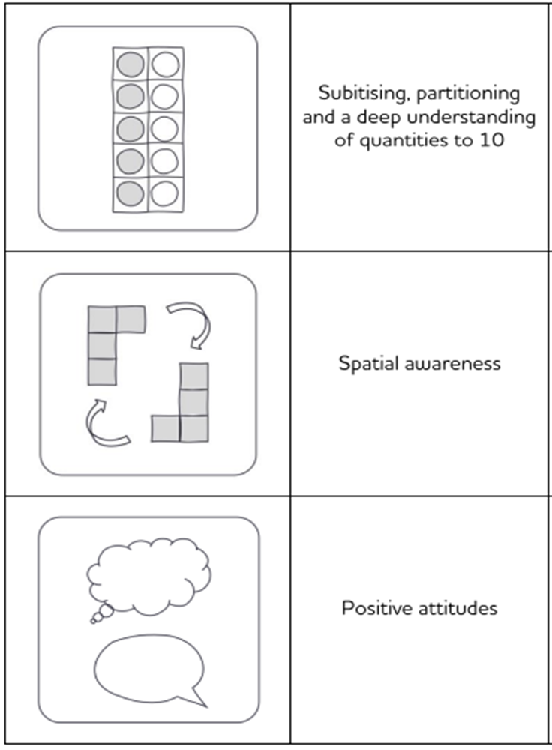
Early Years
The Early Years Number Sense programme builds a deep understanding of quantity and of numbers to 10.
It focuses on developing these key skills.

Slide 7
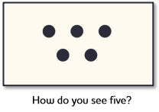
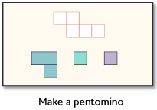
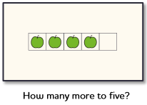
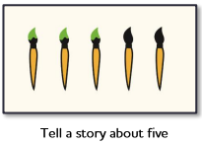
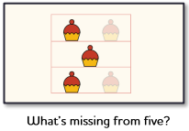
We discuss each number, look at different representations, show animations, look at the different possible number bonds and support children to recall these using a visual approach.

Slide 8
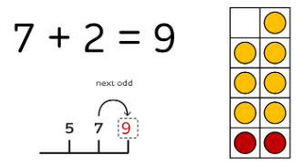
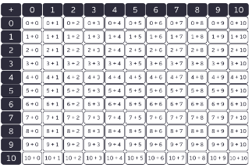
Years 1 and 2
Highly visual
Research informed
Modelled on phonics

Slide 9
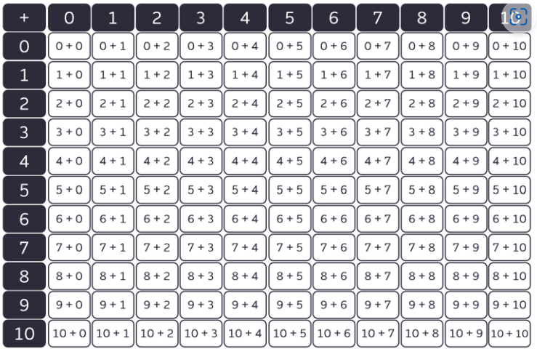
Addition and Subtraction Facts
These essential facts are the equivalent of times tables for addition and subtraction. All future addition and subtraction calculations use these root addition and subtraction facts.

Slide 10
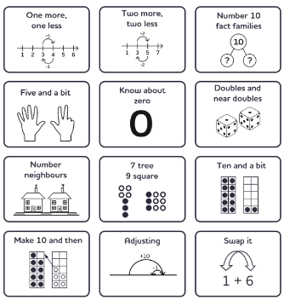
Core Strategies
Using these strategies children can then "use what they know to work out what they don't know".
This helps them to become fluent in addition and subtraction facts.

Slide 11
Structure of a Number Facts Session

Slide 12
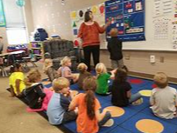
Structure of a Number Facts Session
Number Sense in action

Slide 13
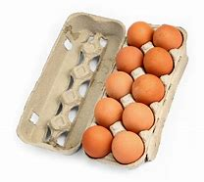
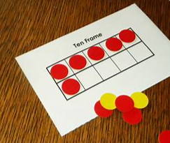
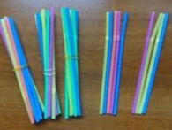
How can I help at home?
Showing the number 10.
How many are missing?
How can different numbers be arranged within the box/tens frame.
Use bundles of straws and other household items.

Slide 14
How can I help at home?
Encouraging children to use the strategies that have been taught in school.
Talking about maths.
There are some resource sheets that teachers may send home to consolidate learning.

