Slide 1


THE TASS COMMUNITY:
GROWING AND LEARNING TOGETHER
Every day excellence for EVERY child
Parent Workshop
Year 4 Multiplication Check
“I have come that they may have life, and have it to the full.”
John 10:10

Slide 2
What is the Year 4 times tables check?
The Year 4 Times Tables Check, or Multiplication Check, is an annual check to ensure that Year 4s in England have a good level of times tables knowledge. The Pupil Multiplication Tables Check helps teachers and leaders know which of their pupils know their times tables and can recall them easily, and which pupils may need extra support.
It is important pupils have a strong grasp of their times tables and can recall them fluently. This helps them as they move onto more complex topics. The check is just that – a check, not a test. It is a part of the government’s plan to ensure all pupils have the foundational knowledge and skills they need to succeed at secondary school.

Slide 3
When was the Multiplication Tables Check introduced?
The Multiplication Tables Check (MTC) for Year 4 was due to roll out in 2020 after a 2019 pilot. However, due to the school closures during the 2020 Covid-19 pandemic, the first year of the official roll out was cancelled.
The Multiplication Tables Check 2021 was an optional test for schools to participate in so the Multiplication Tables Check 2022 was the first compulsory Multiplication Tables Check for schools.
This year, the Multiplication Tables Check 2024 is set to be administered by schools between Monday 3rd June to Friday 14th June 2024.

Slide 4
Key Facts
‘Rote learning’ can be used to help learn multiplication tables, but children must be able to recall facts out of sequence, so this also needs to be a focus.
When teaching times tables, if children are supported to make, understand and use the relationships and links within multiplication, this will help them to gain the ability to rapidly recall their multiplication facts. They will be able to use them to help them calculate in other areas of maths as well.
As the facts have to be read by the child (rather than being read to them), it is also important that children are used to giving the correct answer to multiplication questions in a written format, rather than only answering questions out loud when they are read out to them.

Slide 5
The MTC
1. The times tables check is online and on-screen
The test is fully digital and takes place on screen. It is available to use on laptops, desktops and tablets.
2. Schools will have access to a simulated version to practise on
During this time schools can apply any necessary accessibility features for pupils that may need them. Pupils should try these features out ahead of the check window to ensure they work for them.
3: The MTC only includes multiplication statements, not division

Slide 6
The MTC
4: The check takes place in June
There will be 3-week window in June for the administration of the check. There is no set test day, nor an expectation that all children will take the check at the same time.
5: Children can practise before taking the check
Before the test window opens each year, there will be the opportunity for children to access a practice area to become familiar with the style of the KS2 times tables test.
6: It takes less than 5 minutes per pupil
Under standard administration (i.e. without any access arrangements), the multiplication check will take less than 5 minutes per pupil.

Slide 7
The MTC
7: Children will have 6 seconds to answer each question
Children will get 6 seconds from the time the question appears to input their answer. This means that children must be able to read, recall and enter their response within 6 seconds.
Children will enter their answer using a keyboard or by pressing digits using a mouse or touchscreen on an on-screen number pad.
Children must be able to recall times tables facts in random order.
8: Whatever is in the answer box at the end of the 6 seconds will be counted as the answer
9: There are 25 different questions

Slide 8
The MTC
10: There will not be an equal spread of each multiplication table within the check
The check has been designed to focus on times tables that fit within the KS2 national curriculum.
There will always be questions from the 3, 4, 5, 6, 7, 8, 9, 11 and 12 multiplication tables in each test.
There will be no questions from the 1 times table (i.e 1 x 8 or 8 x 1)
There will only be a maximum of 7 questions from the 2, 5 and 10 times tables. Reversal of questions using the commutative law will not feature in the same check. This means that, for example, 8 x 3 and 3 x 8 won’t be asked to the same pupil.

Slide 9
The MTC
11: Results will be available at the end of the 3-week window
School can access the result for each pupil at the end of the 3-week window.
12: There is no ‘Pass’ rate or threshold
The guidance is clear that there is no expected pass rate or threshold. This means that, unlike the KS1 Phonics Screening check, children will not be expected to re-sit the check if they do not meet a set threshold in this KS2 Times Tables Test. BUT…
13: National and Local Authority results will also be published
The DfE will report on the performance of pupils in the check nationally and in each local authority, but won’t publish school’s data in performance tables.

Slide 10

Pupils should not take the check if they:
are absent during the entire 3-week check period
are working below expectation for year 2 in multiplication tables and are considered unable to answer the easiest questions.
Otherwise, all children in Year 4 are expected to take the check.

Slide 11
Times Table Rockstars
Times Tables Rock Stars is a maths programme that boosts children’s fluency and recall in multiplication and division.
Suitable for all learners aged 6 years and up, question-based games automatically adapt to each child’s unique learning needs, helping them to recall their times tables in record speed. Accessible on any device, via the app or browser, children can play anytime, anywhere.
The gamification and motivating rewards helps to engage children.

Slide 12
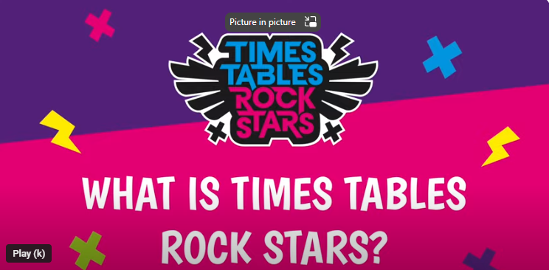
What is Times Tables Rock Stars? (youtube.com)

Slide 13
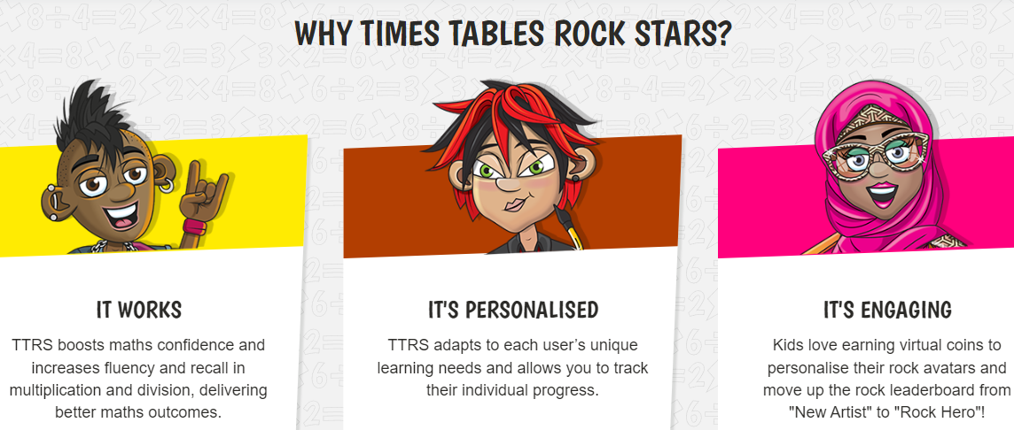

Slide 14
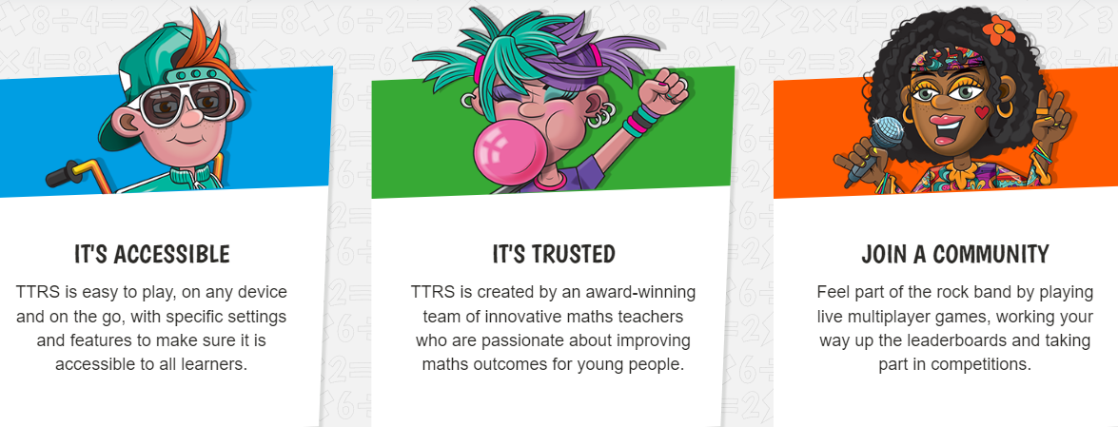

Slide 15
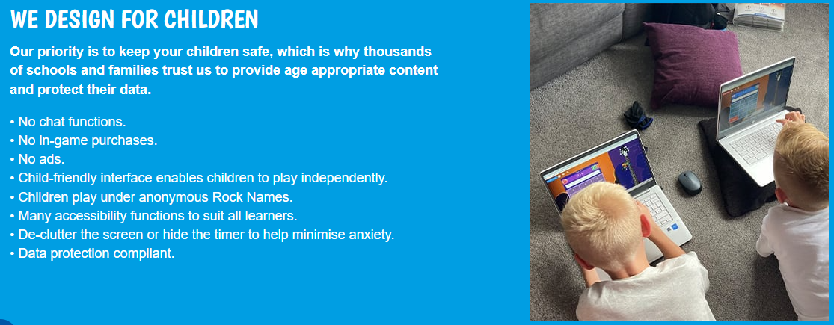

Slide 16
Different games on TTR
GIG – to create a benchmark
GARAGE – for personalised practice
JAMMING – to raise confidence
STUDIO, FESTIVAL, ROCK SLAM – to motivate
SOUNDCHECK – to standardise a check
ARENA – classroom fun
Year 4 demo

Slide 17
Thank you
Any questions?

